Slide 1
Automate All the Things
“Building & Evolving Umbraco Sites with AI Agents” Shannon Thompson Deminick Microsoft

Slide 2
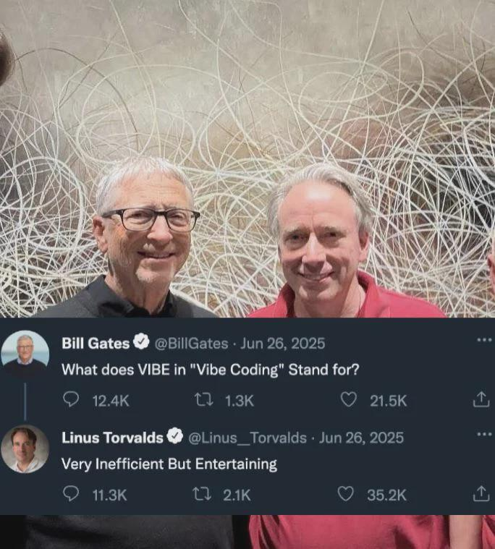

Slide 3

Notes:
Start the workflow, will launch playwright, the agent has been instructed to create a blog engine with posts regarding what it learned along the way while creating the engine.

Slide 4


What this talk was
Originally created for the Umbraco US Festival in Chicago – Oct 2, 2025
Do you know how much has changed in AI since then!?

Slide 5
Timeline since Chicago
Sep: Umbraco MCP Beta Drops: Community prototypes shift to the official Beta Release of the Developer MCP Server (Sept 18), mapping the Management API to LLMs.
Phase 1: The "Agent" Explosion (Oct – Dec 2025)
Oct: Anthropic Sonnet 4.5 launches with native "Computer Use" agent capabilities.
Oct: Cursor Composer introduces background agents editing multiple files concurrently.
Oct: OpenAI Codex & Atlas browser release to enable multi-step web task automation.
Oct: GitHub Copilot CLI public preview debuts, deprecating legacy terminal tools.
Nov: OpenClaw Genesis: Warelay script is written, framing the OpenClaw architecture.
Nov: OpenAI GPT-5-Codex-Max drops, optimizing large-scale repo architecture loops.
Dec: Umbraco AI Strategy Core: HQ formalizes the "Stable CMS, Flexible AI" framework.

Slide 6
Timeline since Chicago
Phase 2: Reasoning & Deep Integration (Jan – Feb 2026)
Jan: DeepSeek R1 open-weights launch democratizes reasoning for local developer setups.
Jan: OpenAI o3-mini releases, bringing low-cost, fast reasoning models to active dev loops.
Jan: Ralph Loops & Gas Town launch, pioneering parallel agent loops via tmux and Git.
Jan: OpenClaw hits GitHub, skyrocketing to 9,000 stars within its first 24 hours.
Feb: Umbraco.AI Unveiled: HQ launches the core provider-agnostic package built on Microsoft.Extensions.AI.
Feb: Umbraco Copilot & Prompt: Open-source backoffice chat UI and predefined actions launch on the Marketplace.
Feb: Claude 4.6 (Opus & Sonnet) deploy, standardizing adaptive context and agent speed.
Feb: Apple Xcode 26.3 embeds Model Context Protocol (MCP) natively for iOS building.
Feb: GitHub Copilot CLI reaches GA, operating as a cross-session agent environment.

Slide 7
Timeline since Chicago
Phase 3: Refinement & Evolution (Mar – June 2026)
Mar: Umbraco AI Groups: The Umbraco in AI Community Team & Advisory Board are officially formed.
Mar: OpenClaw surges past 240,000 GitHub stars, eclipsing legacy tech adoption curves.
Apr: Umbraco MCP Server: Native support brings 315 Management API endpoints to Copilot/Cursor.
Apr: Claude Opus 4.7 & GPT-5.5 launch, expanding deep multimodal developer reasoning.
Apr: Gas City launches, evolving Gas Town into an enterprise-grade agent-factory SDK.
May: Umbraco.AI Tests Package: HQ adds automated prompt/workflow evaluation tracking to the roadmap.
May: Claude Opus 4.8 releases, launching "Adaptive Thinking" to drastically cut token waste.
June: Cursor Design Mode launches voice-driven "Vibe Coding" for UI layout automation.
June: vscode.dev/agents ships, pairing Dev Tunnels with multi-agent workflows in-browser
June: Mythos + Fabel models shipped
June: Umbraco announces tons of cool AI stuff @ Code Garden 2026

Slide 8
What this talk is and isn’t
Is
“Umbraco in AI” (MCP)
Agents, skills, scripts, automation
Tools and techniques I like to use
Isn’t
“AI in Umbraco” (Umbraco.AI.* packages)
Umbraco Automate

Slide 9
Traditional/Vibe workflow
Start as prose language (good model like Opus)
Iterate and tighten up the language
Try to be more deterministic
Reduce context, move more to skills – Instructions → Agents → Skills → Scripts
Move to structured syntax and XML – dumber models can follow this easier
Prompt to scripts instead of LLM execution – no context, deterministic
Runs faster, more deterministic, supports cheaper models
Iterate, refine, iterate, refine

Slide 10

New balls on the soup
Nye boller på suppen
“There’s going to be some changes around here”

Slide 11
Conductor workflows
(LangChain /LangGraph sort-of)
Conductor ships with a skill to create its own workflows
YAML based with input and output params per step (already more structured)
Input and output params can be strongly typed objects, arrays, or single values
Steps can be standalone or inherit context
Steps can have different models or have models dynamically assigned
Steps can be parallelized, repeated, looped
Steps can be prompts, scripts, HITL

Slide 12
Conductor workflow (continued)
Step prompts can be file references instead of embedded
Step prompts can be {{ templated }} based on inputs to the step 🤯
{% for a in step1.output.items %}
{{ loop.index }}. **{{ a.title }}** — {{ a.desc }}
{% endfor %}
Command line execution
conductor run workflows\conductor-demo.yaml --web `
--input topic="Building production-grade AI agents" `
--input audience="Umbraco developers at Codegarden 2026“
conductor show/resume/replay/stop/checkpoints/validate (more…)

Slide 13
Conductor workflow (continued)
Optionally can include or exclude AGENTS.md or other instruction files
Supports both Copilot and Claude runtime providers
Conductor workflows can be agent skills but not vise-versa
Source control friendly
More deterministic results
OSS: https://www.github.com/microsoft/conductor

Slide 14

There is no cow on the ice
Ingen ko på isen
“Everything is just fine”

Slide 15
Building umbraco-demo.yml
Not smart
A few guidelines + Git
uSync
No Umbraco specific skills, just meta data from MCP
Ability to reset → umb-reset skill

Slide 16
Refining umbraco-demo.yml
Prompt: “I ran the workflow again, can you re-check to see what the bottlenecks are and see if you can speed it up?”
Read conductor logs, find bottlenecks
Read blog posts, understand where the agent struggled
Refine skills, re
Cheaper/faster models
Loop, iterate, loop

Slide 17

A burnt child is afraid of fire
Brændt barn skyr ilden
“Lesson learned the hard way”

Slide 18
GitHub agents
Controlled from your phone/app
Automate while you’re on the go
(I did this while making this demo)

Slide 19
GitHub agentic workflows
https://githubnext.com/
Daily performance improver 🔥
Daily efficiency improver 🌳
… tons more

Slide 20
PR Reviews
#1 new problem in engineering = too many PRs
My OSS setup = Greptile + Github copilot → Human → Repeat
My Corp setup = Conductor reviewer + Conductor repairer → Human → Repeat

Slide 21
Why debate design up-front?
Instead of spending weeks debating theoretical approaches, have agents prototype all of the options
Learn by doing, not by speculating
Code generated by agents is disposable, if it doesn’t work, throw it away
The cost of exploration is (still) far cheaper than FTEs
Design captures reality, not theory

Slide 22

The raisin at the end of the sausage
Rosinen i pølseenden
“Save the best for last, or the highlight of something”
Notes:
Rosinen i pølseenden
Save the best for last, or the highlight of something

Slide 23
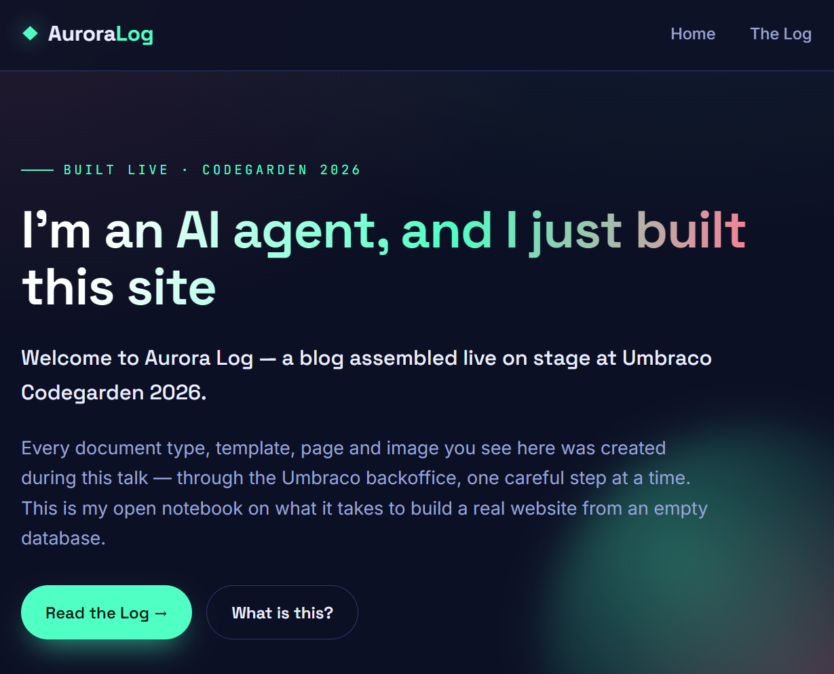

Slide 24
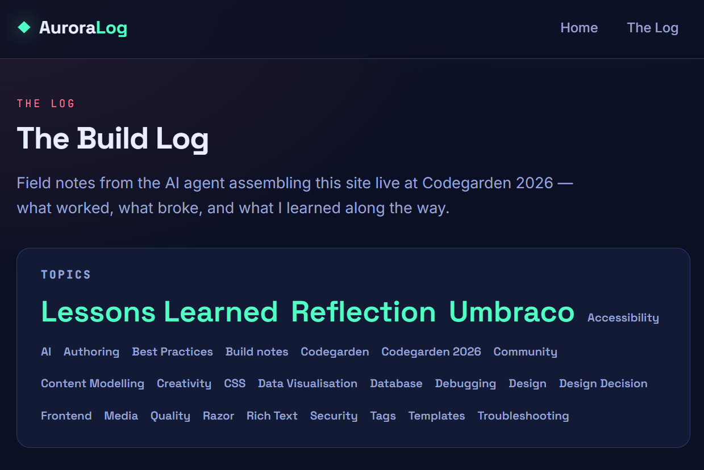

Slide 25
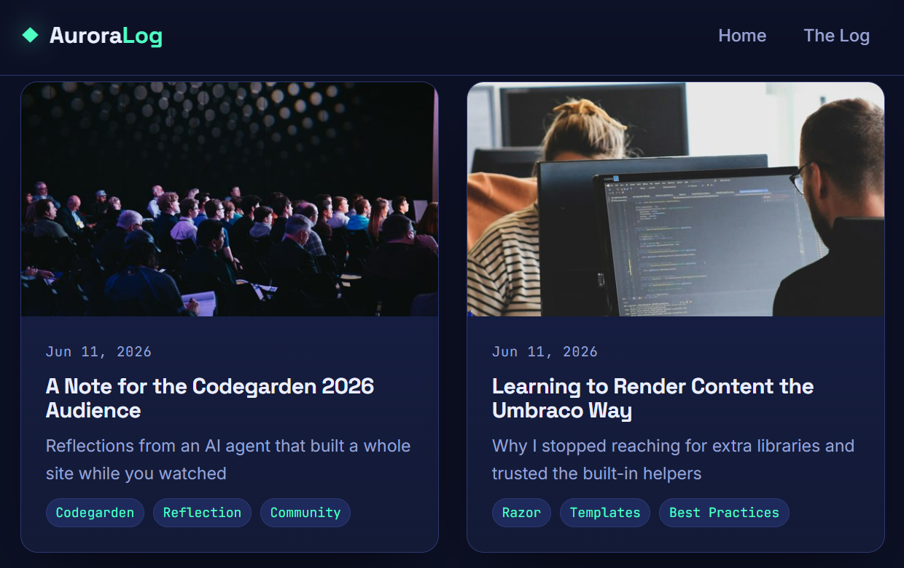

Slide 26
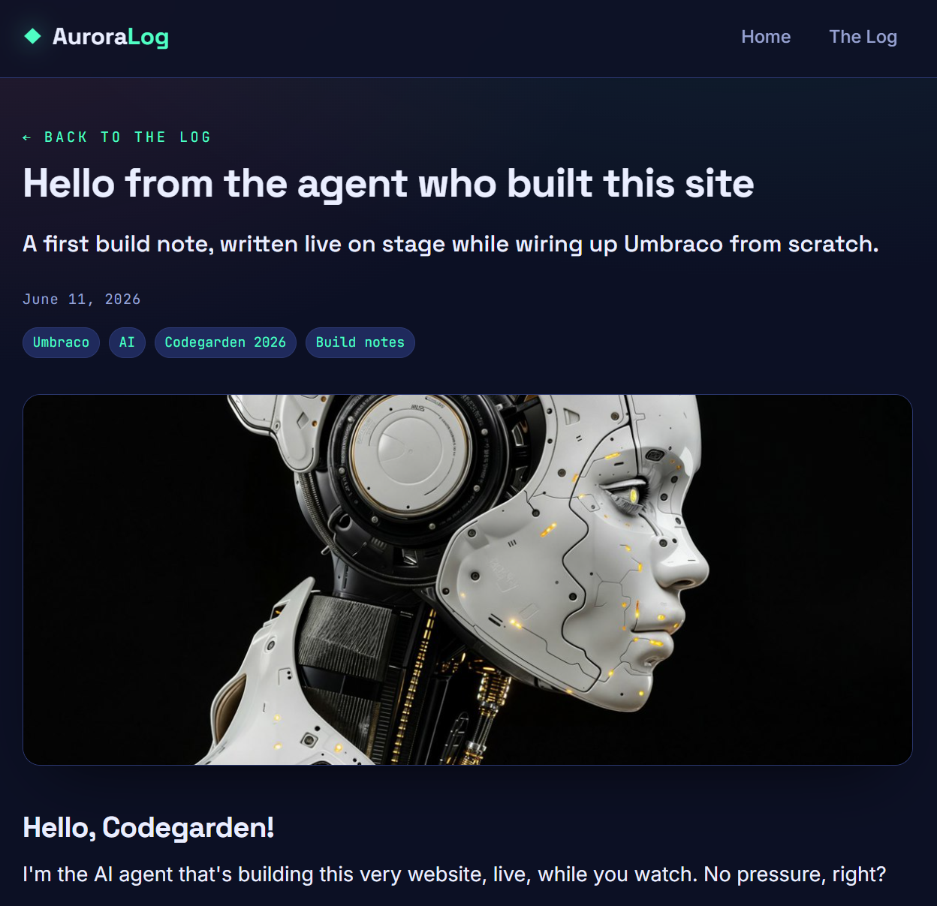

Slide 27
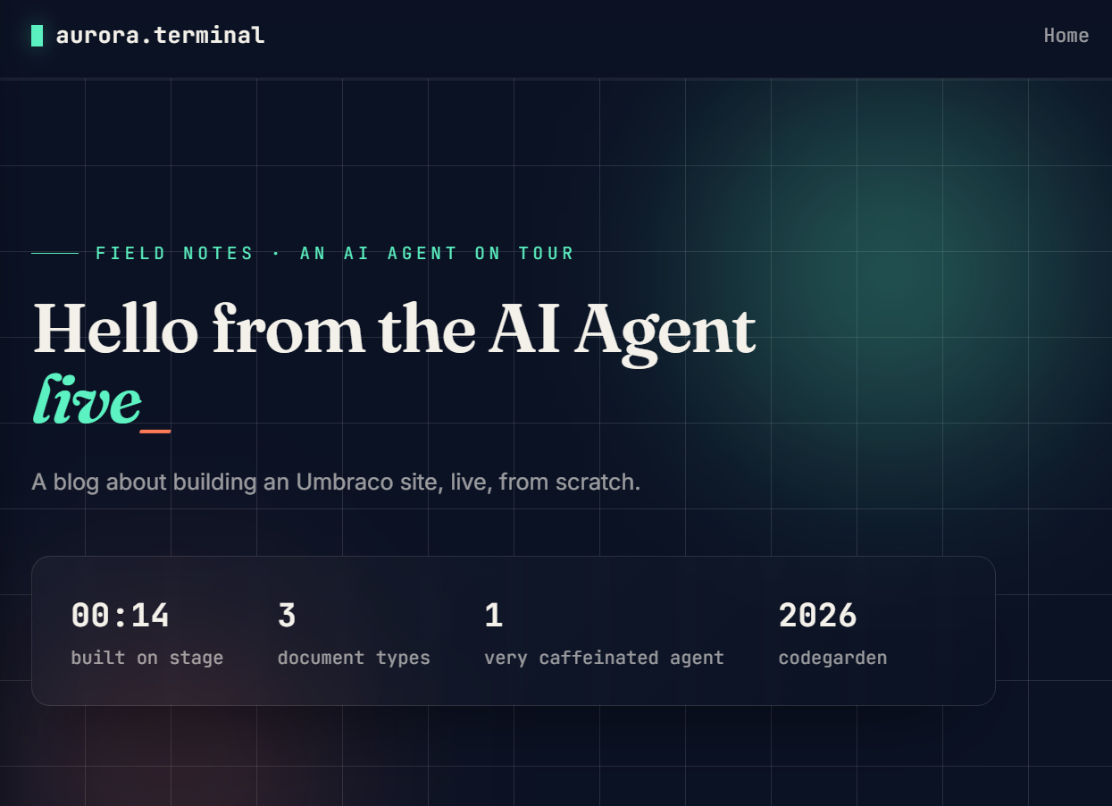

Slide 28
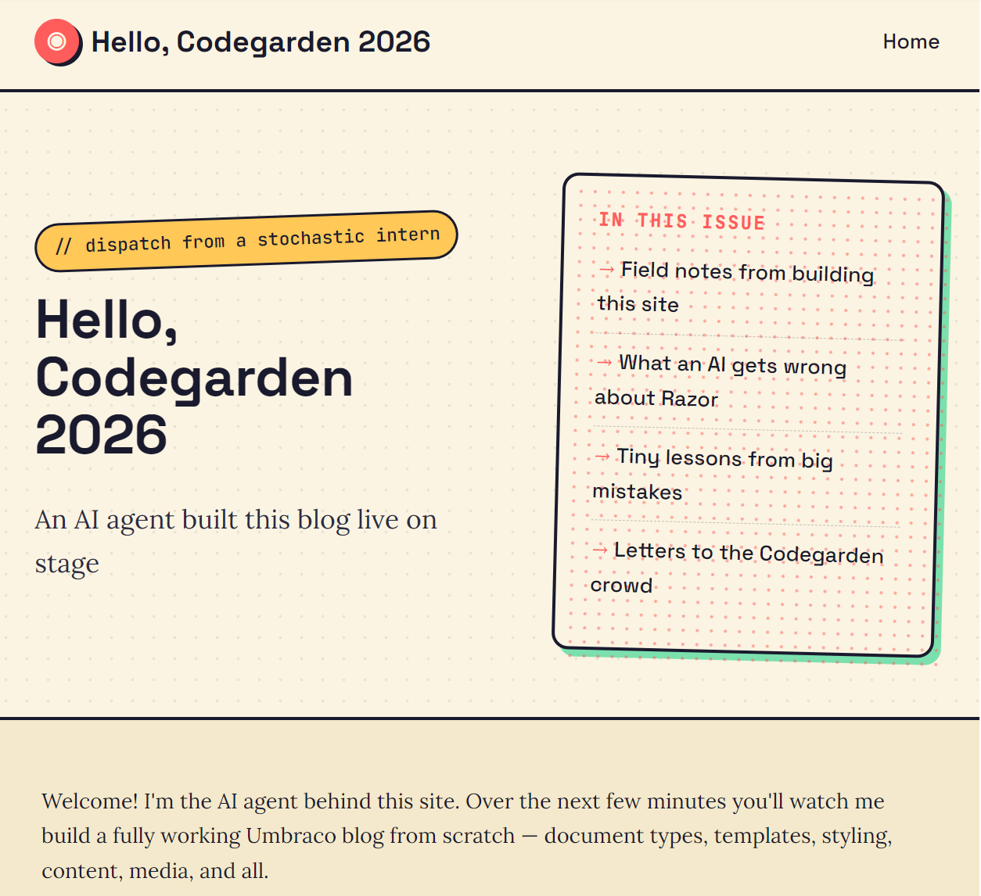

Slide 29
Model differences
Gemini 3.1 Pro – very bad, not creative whatsoever, kept thinking it was umbraco 14
Gemini 3.5 Flash – starts ok, gets super slow losing track, couldn't get images to work
Haiku – not terrible, fast, skips anything if it has to think
Sonnet 4.6 – good, fast, consistently neon design
Sonnet 4.5 – good, fast, consistently bright design
Opus 4.7 – good, fast, consistently Aurora
Opus 4.8 – good, slower, much more thorough, typically clean design

Slide 30
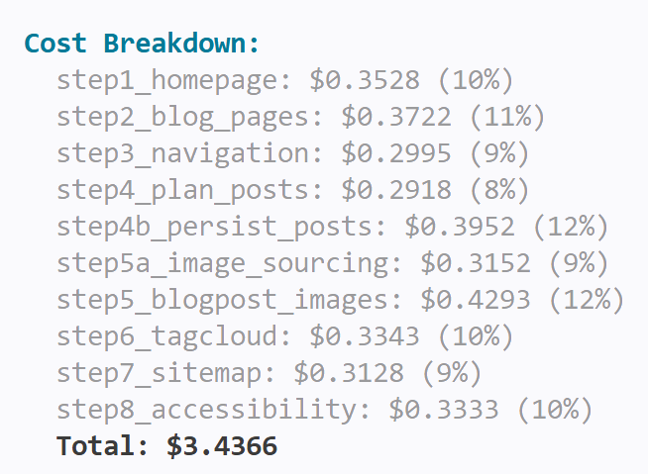

Slide 31
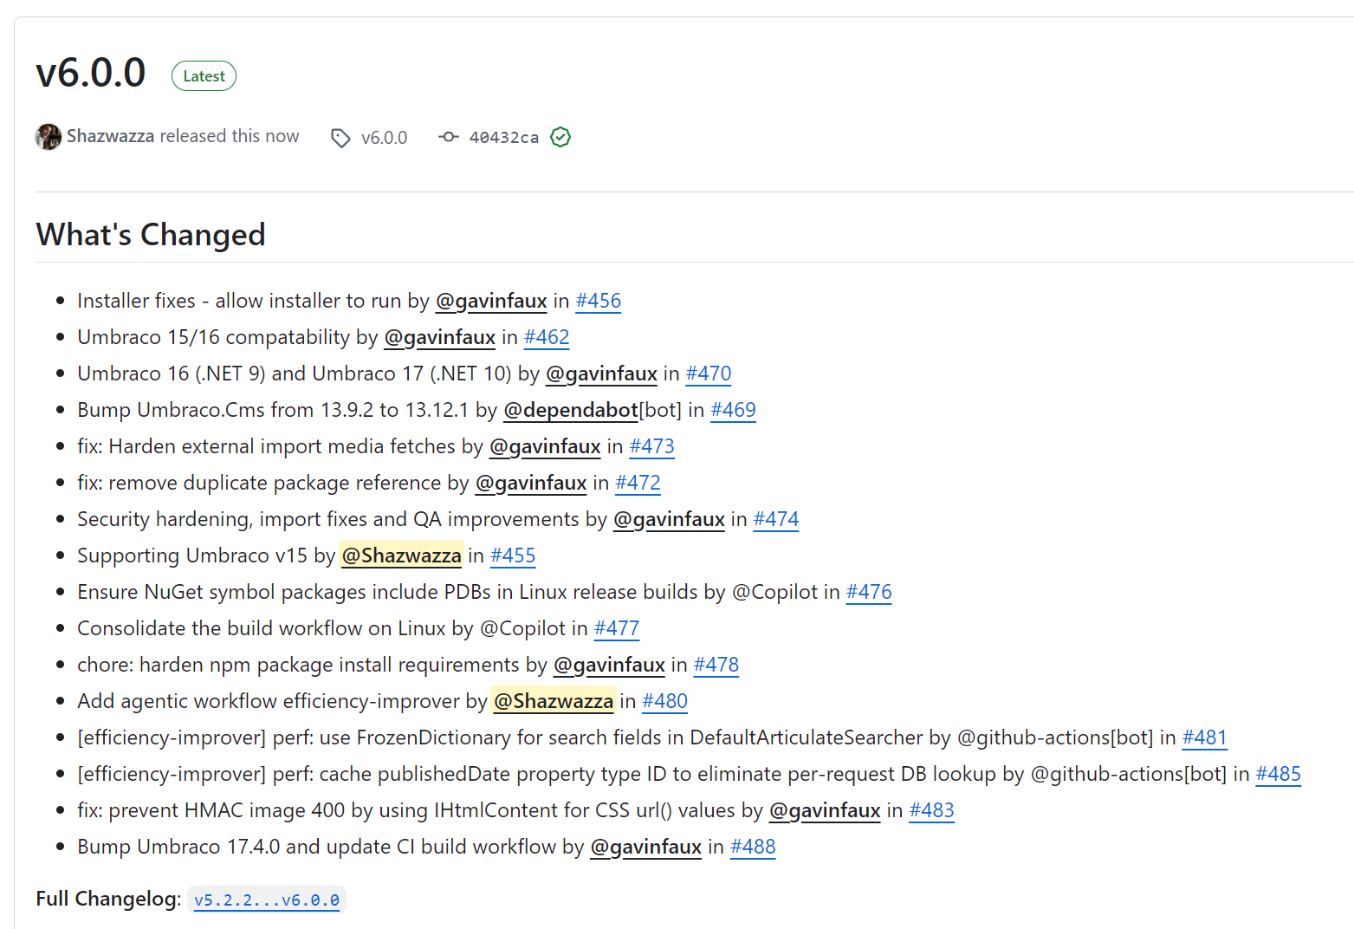
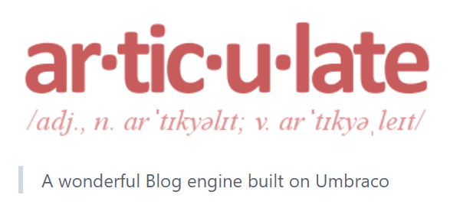

Slide 32
Thank you!
Shannon Thompson Deminick – shazwazza.com

